Slide 1

Samvidhan-Sathi
Your AI Legal Aid Companion for India
Empowering citizens with instant, constitutional guidance through cutting-edge artificial intelligence
Created By SAGNIK GOPE

Slide 2
PROBLEM & SOLUTION
Bridging the Legal Gap
The Challenge
Our Solution
Indian laws are notoriously complex, with over 1,500 Central Acts and countless state-level statutes. Legal representation remains prohibitively expensive for most citizens, and widespread legal illiteracy leaves millions vulnerable to rights violations.
Samvidhan-Sathi acts as an AI "First Responder" — delivering instant, simplified legal advice grounded strictly in the Indian Constitution. Think of it as having a constitutional expert available 24/7, democratizing access to legal knowledge.

Slide 3

Built with Modern AI - Kept with Privacy
Core Framework
Python 3.10+ powers the backend with Streamlit delivering an intuitive, responsive UI for seamless user interactions
Workflow Intelligence
LangGraph orchestrates stateful, multi-step reasoning flows that maintain context across complex legal queries
Knowledge Foundation
ChromaDB vector store combined with COI.json ensures rapid retrieval of constitutional articles and provisions
Hybrid AI Engine
Groq delivers cloud-speed inference while Ollama enables complete local privacy for sensitive legal matters

Slide 4

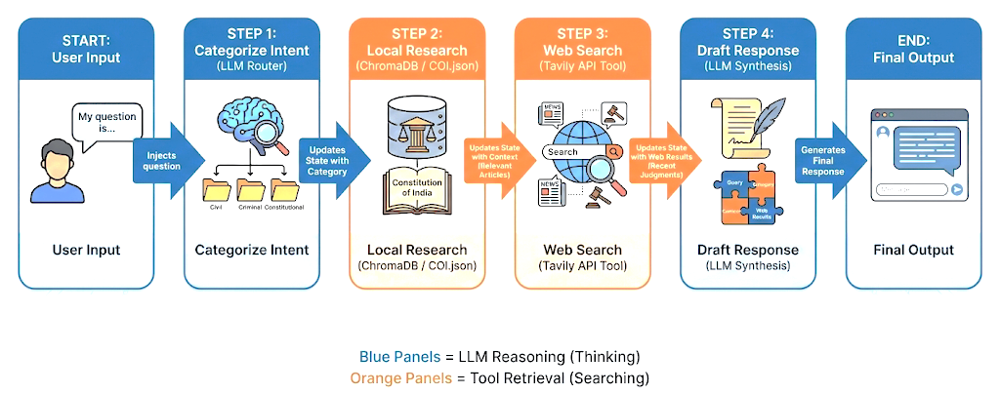
Intelligent Architecture
Our hybrid RAG (Retrieval-Augmented Generation) system combines the precision of constitutional data with real-time legal intelligence
User Query
Categorizer
Retrieve
LLM Synthesis
The system intelligently categorizes each query, retrieves exact constitutional articles from local storage, cross-references with recent 2025 judgments via web search, and synthesizes everything into actionable, plain-language advice.

Slide 5

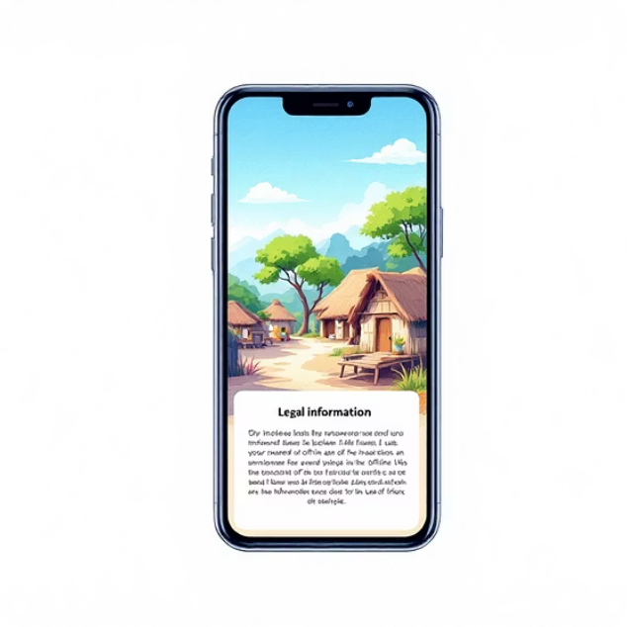

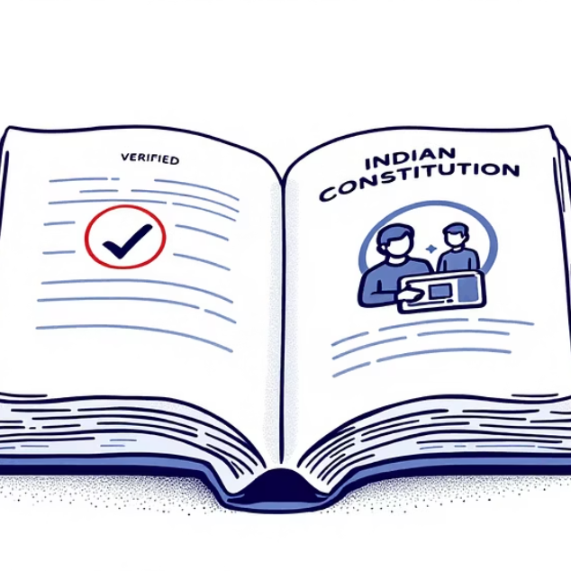
KEY FEATURES
Why It Stands Out
Offline Capability
Contextual Memory
Fact-Grounded Responses
Runs entirely on Ollama's local models, bringing constitutional guidance to rural areas with limited or no internet connectivity
Maintains conversation history, enabling natural follow-up questions like "What is the punishment for that?" without repeating context
Prioritizes primary constitutional sources over general knowledge, dramatically reducing AI hallucinations and ensuring legal accuracy

Slide 6




The Road Ahead
Voice & Language
Integration with Bhashini API for 22+ Indian languages, enabling voice-based queries in regional dialects
Document Intelligence
Upload legal notices, contracts, or FIRs for instant AI-powered summarization and risk assessment
Lawyer Connection
One-click bridge to verified pro-bono lawyers and legal aid volunteers when AI guidance isn't enough

Slide 7
Thank You…

